Slide 1
Student Launch – Y12 and Y13

Slide 2
What is Unifrog?
Unifrog is a one-stop-shop where students can easily explore their interests, then find and successfully apply for their next best step after school.
Unifrog will help you to explore your key interests and what career paths you can take to reach your goals!

Slide 3
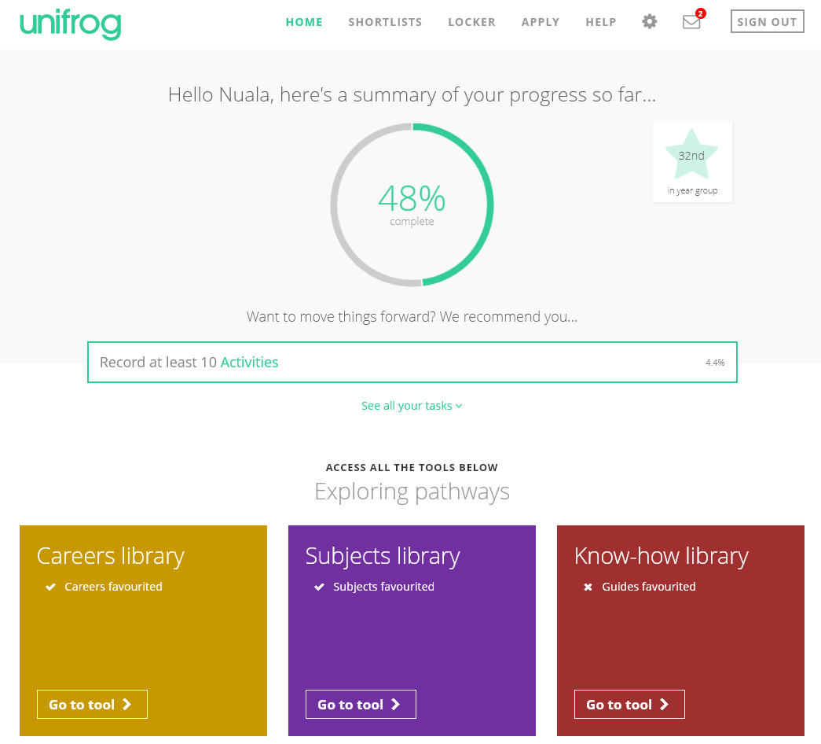
By the end of today’s session, we will have:
Understood how Unifrog can support your future decision-making and career options.
Explored some of the exciting features of the platform.
Created your very own personal Unifrog accounts!

Slide 4
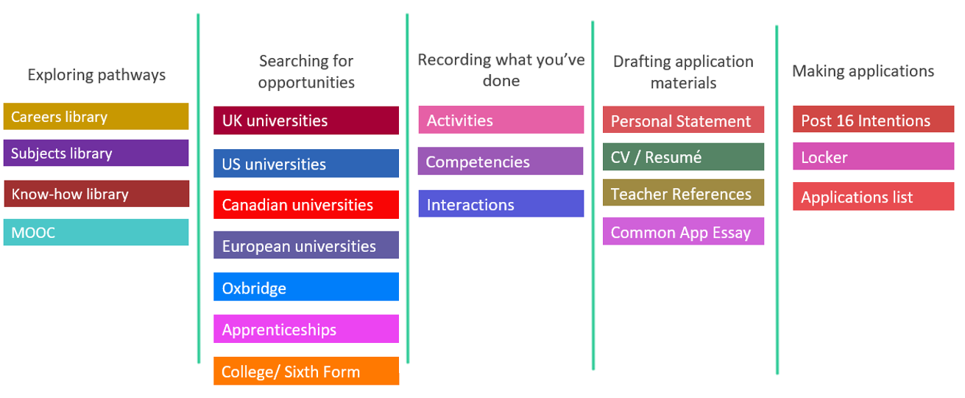
Available resources

Slide 5
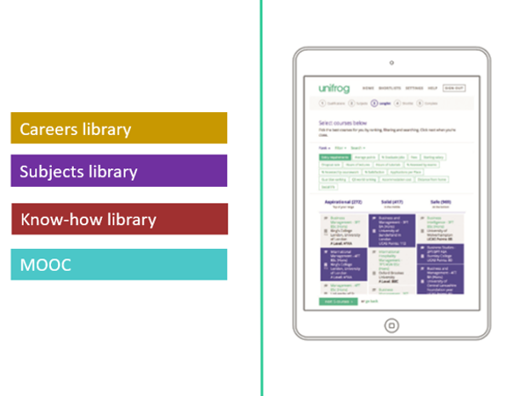
Exploring pathways
Use the tools in the Exploring pathways section to research the career pathways and subject fields that lie beyond school or college and understand how to access them.

Slide 6
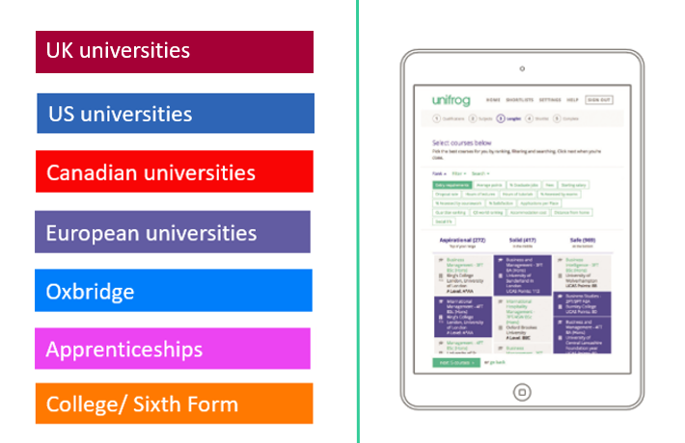
Searching for opportunities
Use the tools in the Searching for opportunities section to compare universities, degree options, apprenticeships and college courses.

Slide 7
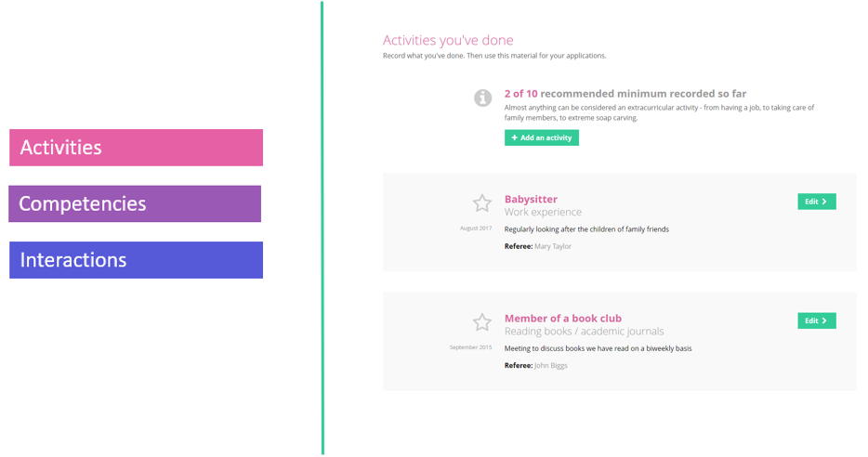
Recording what you have done
Use the tools in this section to start Recording what you have done, using guidance and examples to prepare yourself for making applications.

Slide 8
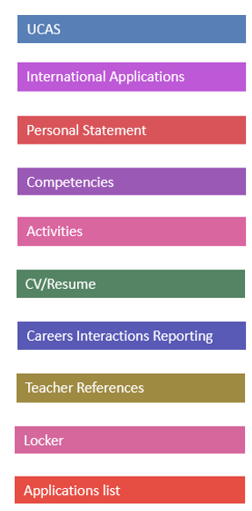
Building applications
Helps you build successful applications.
Enables your teachers to give you fast feedback.
Helps you manage the key parts of your application materials.

Slide 9
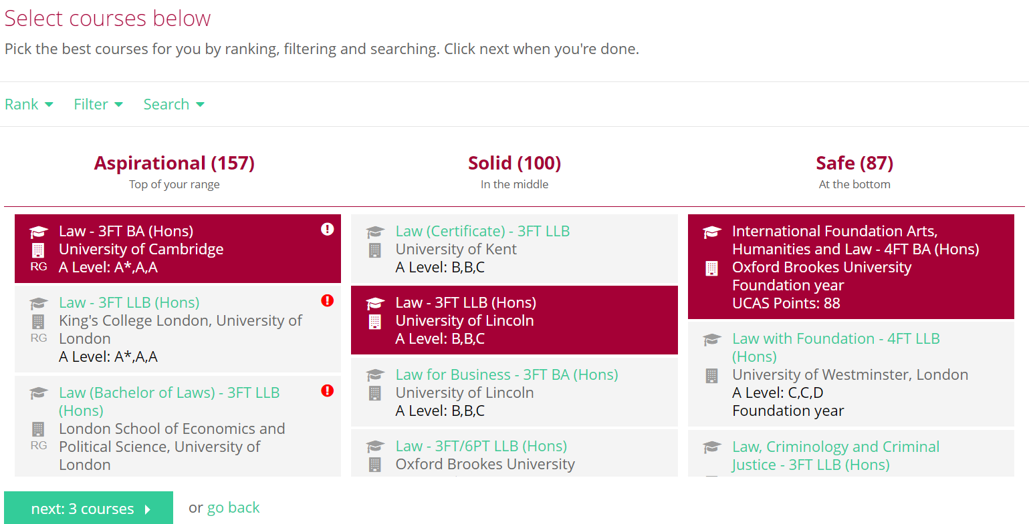
Search Unifrog to find the best university courses for you

Slide 10
Use the ranking and filtering tools to narrow down your university searches

Slide 11
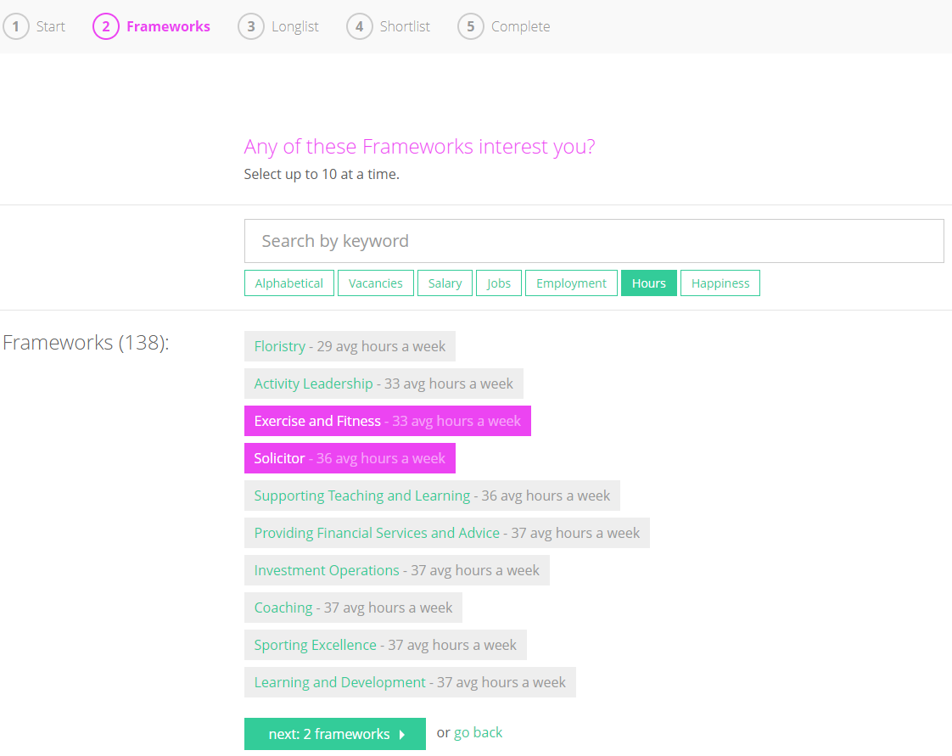
Find Apprenticeships that interest you
Updated every 24 hours, use Unifrog to find Apprenticeships which interest you. There are 3 levels of Apprenticeships available; choose the level that works for you with the qualifications you already have and what you want your next step to be.

Slide 12
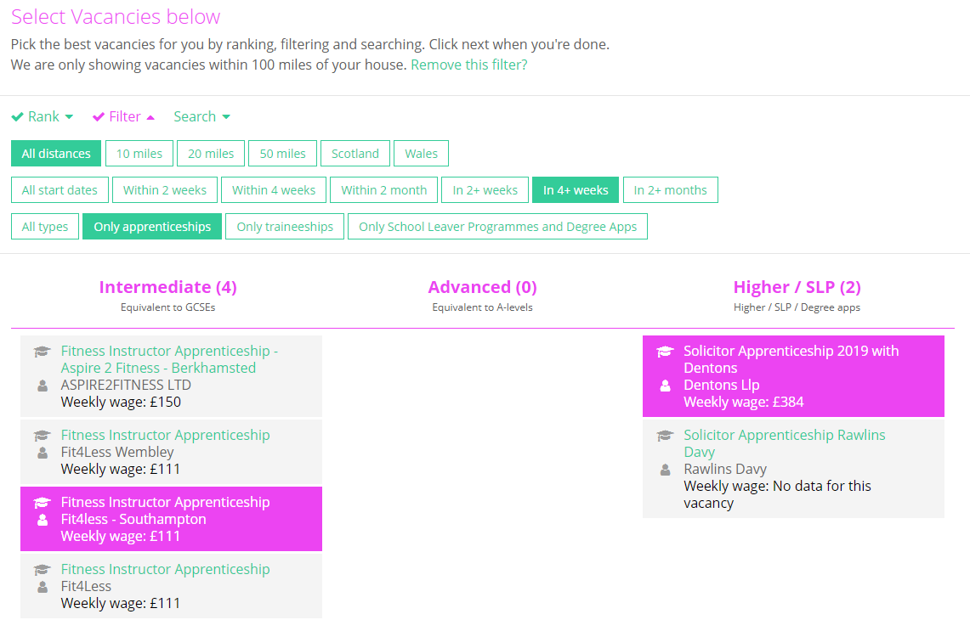
Rank and filter Apprenticeships
Rank and filter apprenticeships to narrow down your searches to what is most important to you.

Slide 13
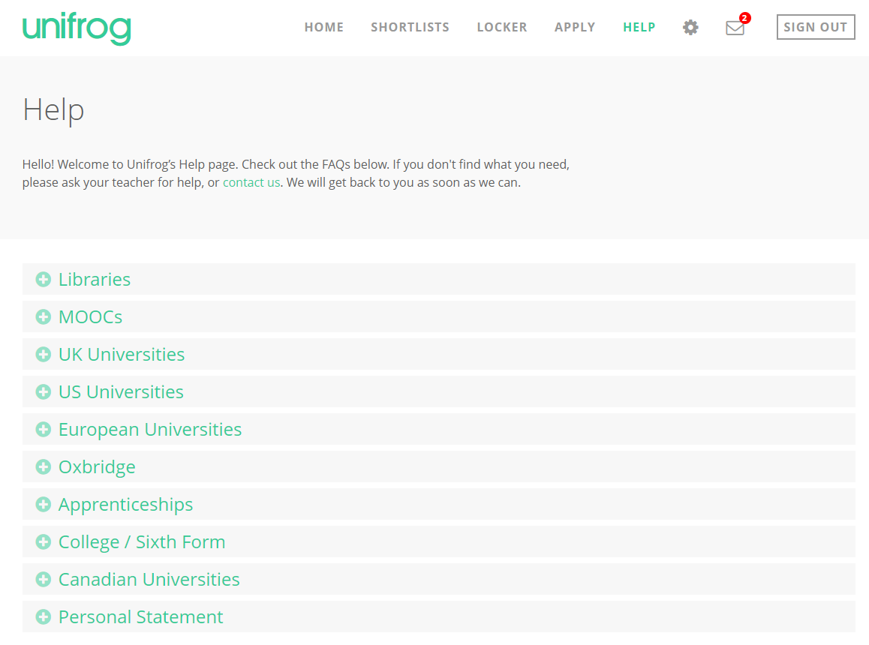
We hope you enjoy using Unifrog!
Use the help section if you need a guide or want some more information about the tools.
If you get stuck, ask your teacher for help!

Slide 14
How can Unifrog help me now?
Explore what subjects you would be interested in studying Post 18 and how these choices can lead to different career paths and further education.
Discover and sign up to online courses in areas that you’re interested in.
Explore how to successfully apply to an apprenticeship or university course, including universities abroad.
Support in writing a CV and Cover Letter.
Record key activities and achievements to use in your application.

Slide 15
Creating your account
A link has been sent to your school email address (please check your junk/spam mailboxes)
Click the link and follow the instructions
Create a memorable password
Make a note of your password
Notes:
Delete this slide if you are using the form code method

Slide 16
Every time you login to Unifrog from now on, sign in here
If you forget your password, hit the link to reset (remember to check your junk/spam just in case!)

Slide 17
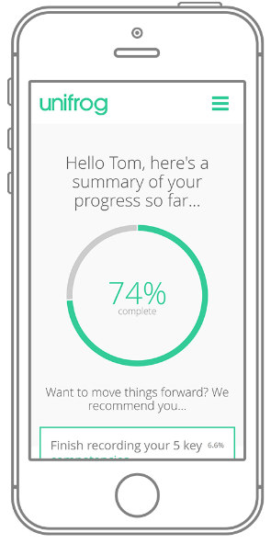
In summary
Unifrog can help you make decisions now about what you want to study and what career path you choose to take.
It will help select the university or apprenticeship that’s right for you.
Be smart. Get ahead of the game!
Sign in now at unifrog.org/sign-in

