Slide 1
PSHE at Magnus Academy

Slide 2
What is PSHE?
PSHE – Personal, Social, Health, Economics Education
Personal – to do with ourselves
Social – to do with our Interactions and relationships with others
Health – all about looking after our bodies, mentally and physically
Economics – all about managing our money

Slide 3
Why study PSHE?
It allows students to gain knowledge and understanding of how to manage their lives now and in the future
It gives students a platform to discuss and explore issues and challenges that they face on a day to day basis in a safe and secure environment

Slide 4
Why study PSHE?
It allows students to make informed choices to help them stay healthy and safe in today’s society.
It fulfils the schools obligation to encourage the spiritual, moral, cultural, mental and physical development of pupils.

Slide 5
Objectives
We want to:
Explain our requirements for RSE
Explain how we currently teach RSE, and get your views on how well this curriculum works.
Get your views on what you think our RSE curriculum should cover
Explain how we’ll develop our updated curriculum.

Slide 6
Why is PSHE/RSE so important?
The following slides show several statistical data of issues students are faced with daily that PSHE hopes to address and empower students to deal with.

Slide 7
Why is PSHE/RSE so important?
1 in 3 adult mental health conditions relate directly to adverse childhood experiences
https://youngminds.org.uk/about-us/media-centre/mental-health-stats/
96% of gay pupils hear homophobic remarks such as ‘poof’ or ‘lezza’ used in school. Almost all (99%) hear phrases such as ‘that’s so gay’ or ‘you’re so gay’ in school
https://www.stonewall.org.uk/documents/school_report_2012%282%29.pdf

Slide 8
Why is PSHE/RSE so important?
More than 16,000 young people are absent from school because of bullying.
http://redballoonlearner.co.uk/includes/files/resources/261298927_r_ed-balloon-natcen-research-report.pdf
60% of 13 to 18 year olds have been asked for a sexual image or video of themselves
http://www.nspcc.org.uk/globalassets/documents/annual-reports/childline-review-under-pressure.pdf

Slide 9
Why is PSHE/RSE so important?
More than 1 in 7 surveyed children aged 11 – 18 (15%) say they have been asked to send self-generated images and sexual messages
NSPCC (2018) NetAware research on file with the NSPCC
7 in 10 young people aged between 13 and 22 have been a victim of cyberbullying
http://www.ditchtehlabel.org/downloads/the-annual-cyberbullying-survey-2013.pdf

Slide 10
What are the RSE requirements?
We must provide the following to all pupils:
Relationships and Sex Education
Health education

Slide 11
What does our curriculum look like now?
What are your thoughts on our current curriculum for RSE and personal, social, health and economic (PSHE) education? Do you think this curriculum meets your child’s needs?
What do we do well? What could we do better?
Is there anything we’re not covering that you think we need to address?
Is there something we could cover more/less?
What do you think about the way we currently deliver RSE to pupils?
As a parent, do you feel like you need more information or guidance on specific topics?

Slide 12
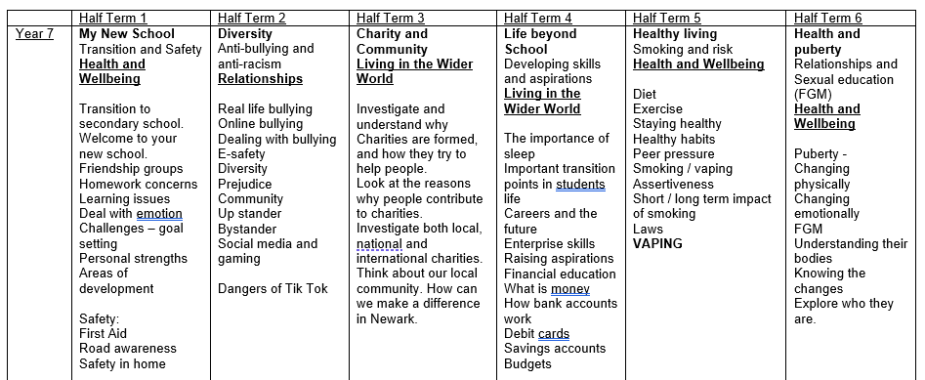
What does our curriculum look like now?

Slide 13
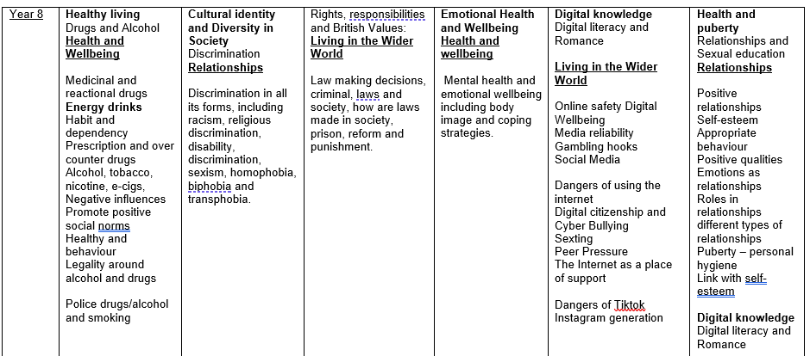
What does our curriculum look like now?

Slide 14
What does our curriculum look like now?

Slide 15
What does our curriculum look like now?

Slide 16
What does our curriculum look like now?

Slide 17
RSE
Year 7 RSE
Introduction to Puberty
Introduction to consent
Puberty
FGM
Menstruation Wellbeing
Toxic Masculinity

Slide 18
RSE
Year 8 RSE
Sexual orientation and Gender Identify
Healthy and unhealthy relationships
LGBTQi+
Consent – avoiding assumptions
Introduction to contraception

Slide 19
RSE
Year 9 RSE
FGM and the Law
Freedom and capacity to consent
Role of intimacy and pleasure
Contraception
Managing the end of relationships

Slide 20
RSE
RSE Year 10
FGM and the Law
Impact of pornography
Love and abuse
Pressure, persuasion and coercion
Sexualisation and the media

Slide 21
RSE
Year 11 RSE
Alcohol and Bad Choices
Importance of Sexual Health
Revisiting Contraception
Revisiting STI’s
Respect and Relationships
Fertility and what impacts it

Slide 22
What happens next?
We’re also getting feedback from:
Staff
Pupils
Governors
Once we’ve considered all the feedback, we’ll draft an updated RSE policy, which will set out our proposed curriculum.
There will be a formal consultation period before the updated policy is approved.
Explain how the policy consultation will work. For instance:
We’ll post the draft policy on our website, and send you an email letting you know how you can feed back
We’ll send a copy of the draft policy home with your child, along with a letter explaining how to send us your feedback

